Slide 1
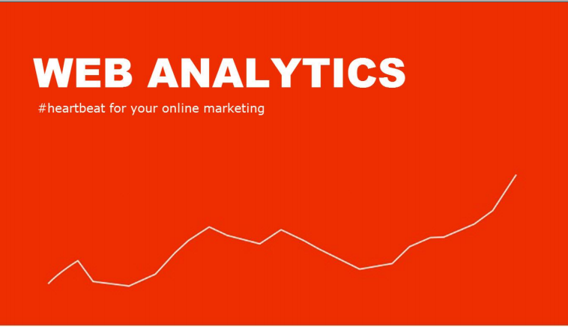

Slide 2
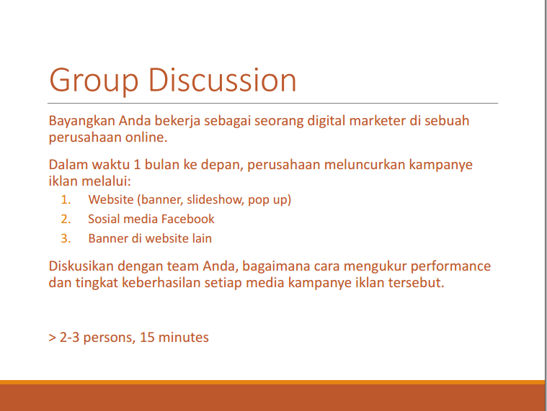
Tidak usah dikerjakan

Slide 3
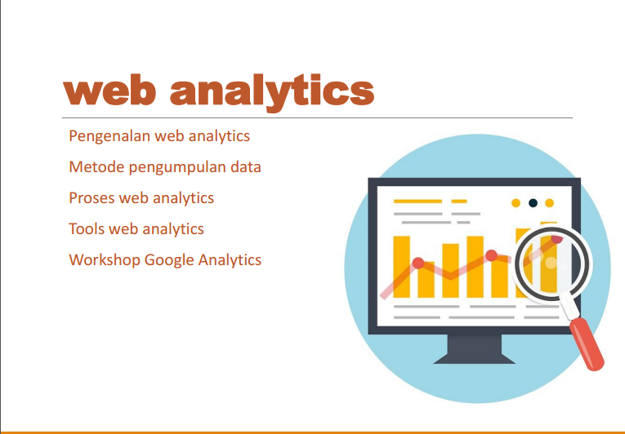

Slide 4
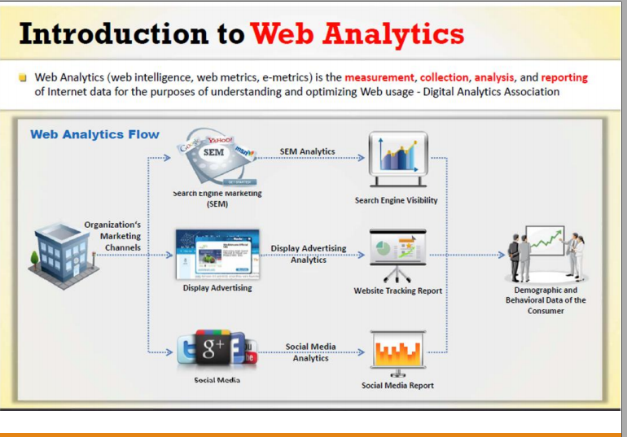

Slide 5
Tujuan Web analytics
Web Analytics
Mengukur hasil advertising
Meningkat
kan kualitas content
Menurun
kan bounce rates
Mentar
get audience
Meningkatkan traffic website
Meningkatkan pengalam
an browsing
Memahami pola traffic

Slide 6
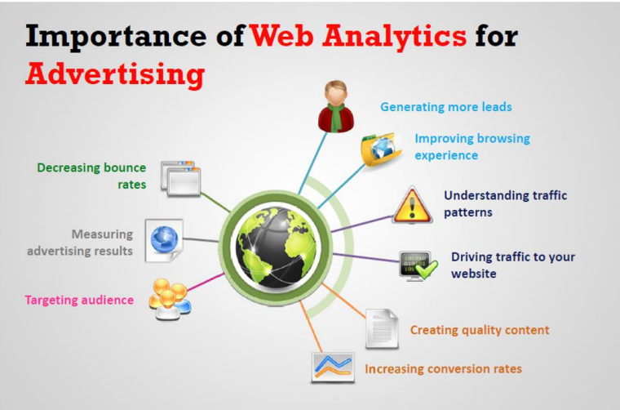

Slide 7
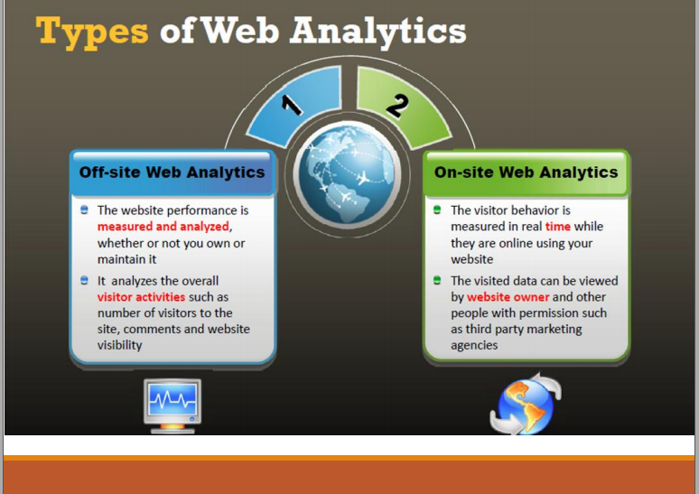

Slide 8
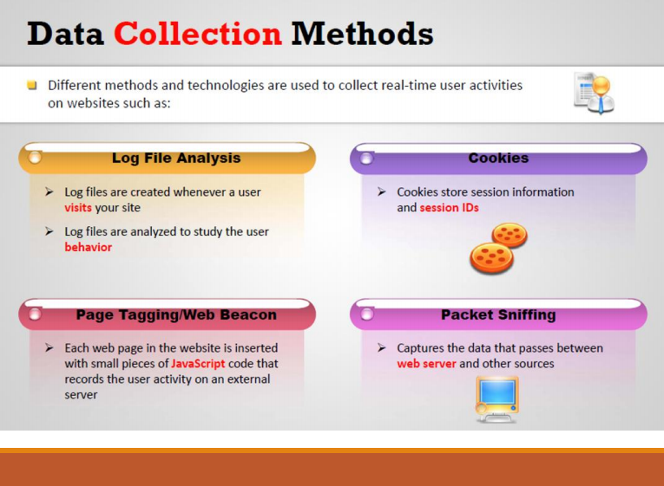

Slide 9
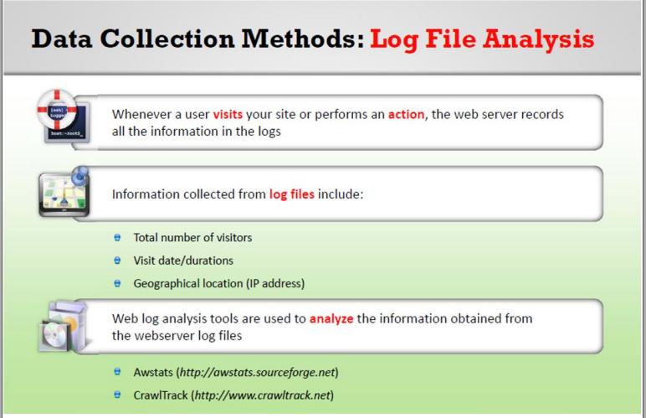
Log adalah “rekaman dari kegiatan didalam system dan jaringan”.

Slide 10
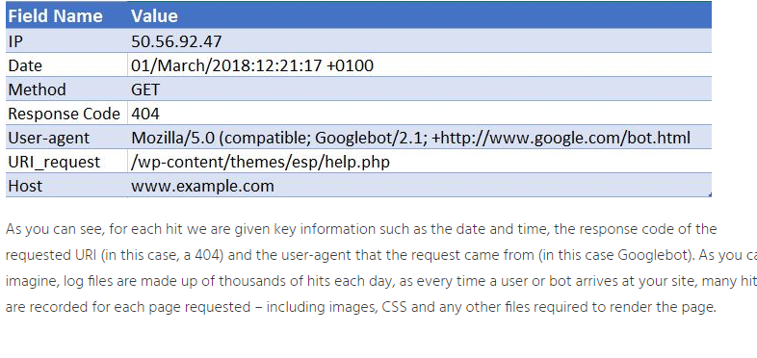
Contoh log file analysis

Slide 11
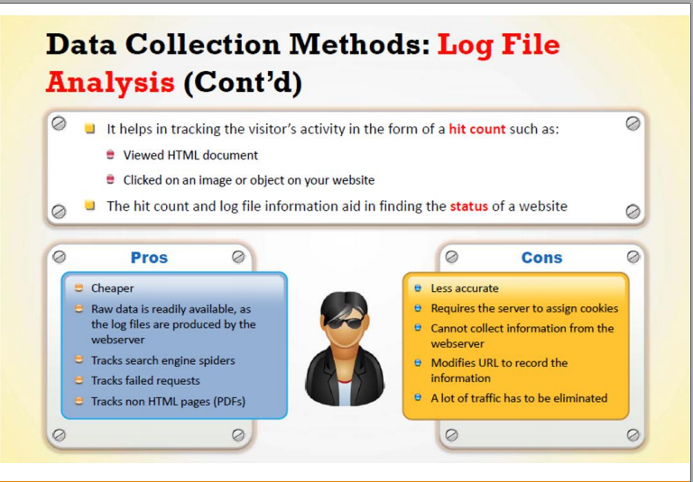

Slide 12
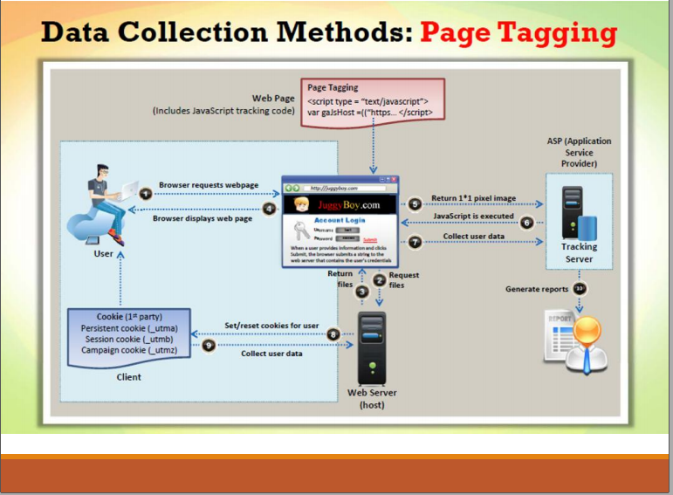

Slide 13
Cara kerja Page Tagging
Page tagging works by inserting a small javascript code on all the pages that you want tracked. This usually works as a hosted solution. So you need to sign up with a web analytics company who would provide you with the code. The cost implications are two fold
The money you pay to the web analytics company on a monthly basis. This is usually based on page views. The more popular your site is, the more expensive it would get.
The effort involved in inserting the javascript code on all the pages.

Slide 14
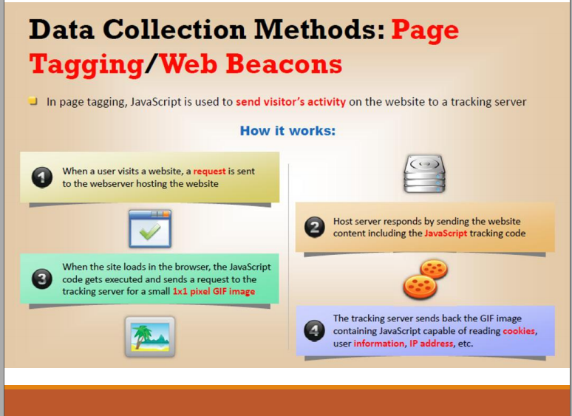

Slide 15
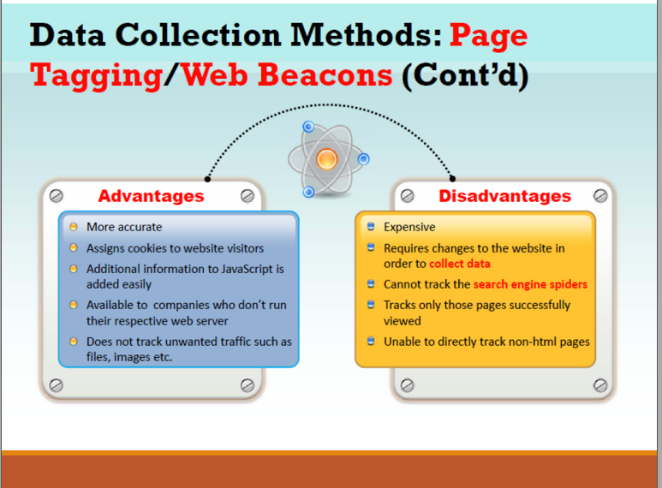

Slide 16
Advantages of page tagging
Easier to get started. As soon as you insert the code on all pages, you can start seeing the data.
Does not require technical people – All you need to do is insert the page tags in all the pages. You don’t need a technical person to manage or maintain the data. It is hosted on the vendor’s machines.
More accurate – Increasingly visitors are being served web pages from proxy servers or cached servers. Log files would never log these hits. But page tagging solution would record these numbers.
No unwanted traffic – Does not track crawlers, images, and other unwanted files.
Disadvantages of page tagging
Data is hosted on someone else’s machine. Per se, this is not a big issue because the vendor is likely to have more security than what you have. But some companies are uncomfortable with the thought of storing their data on someone else’s machine.
Cost – Could get really expensive if you get couple of hundred thousand page views a week and it’s a recurring cost.
Complexity of inserting javascript – if your site is large, complex and does not use templates you might find it difficult to insert javascript on all the pages.

Slide 17
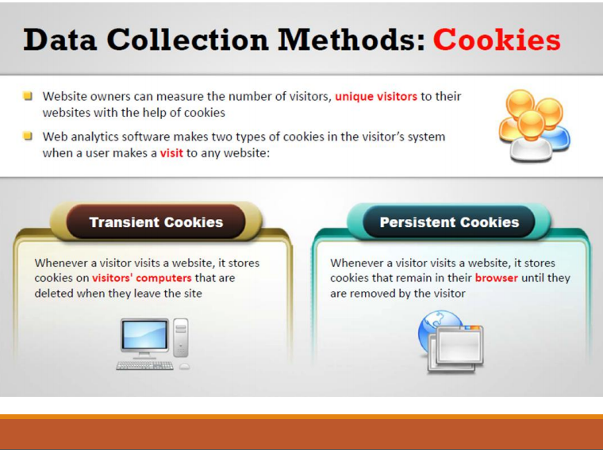
Cookie is a small piece of data sent from a website and stored on the user's computer by the user's web browser

Slide 18
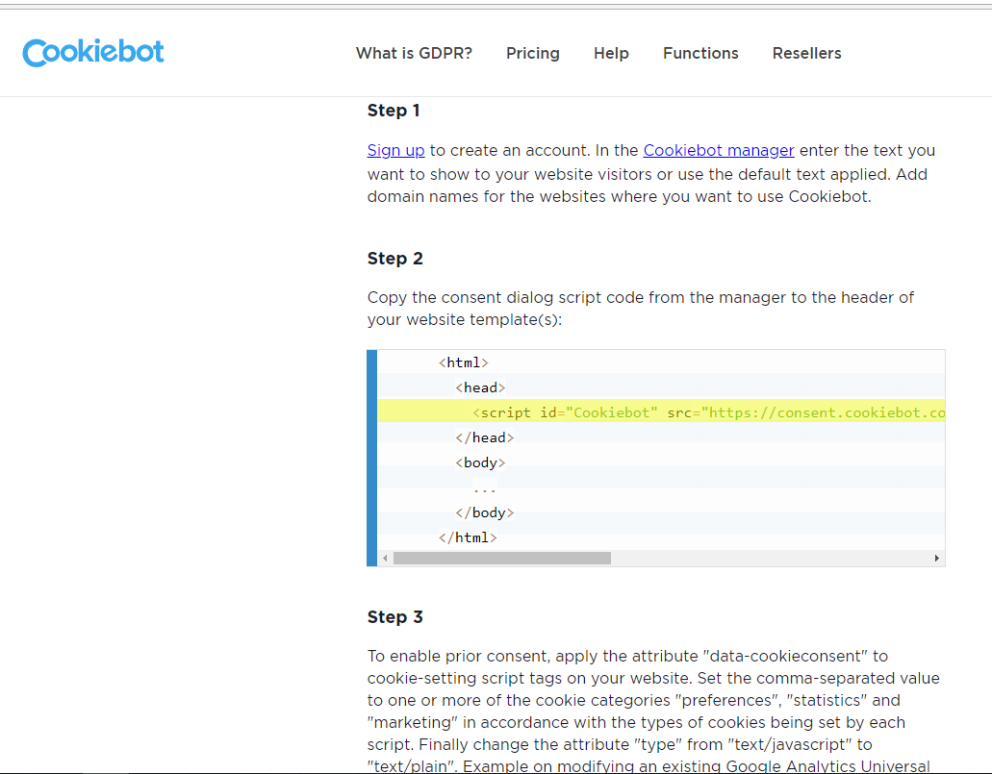
Contoh cek cookie dengan cookie bot

Slide 19
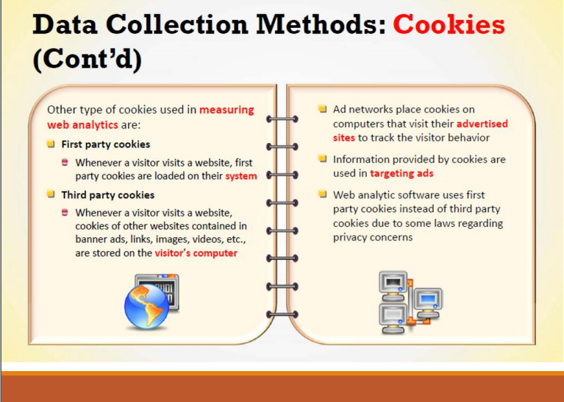

Slide 20
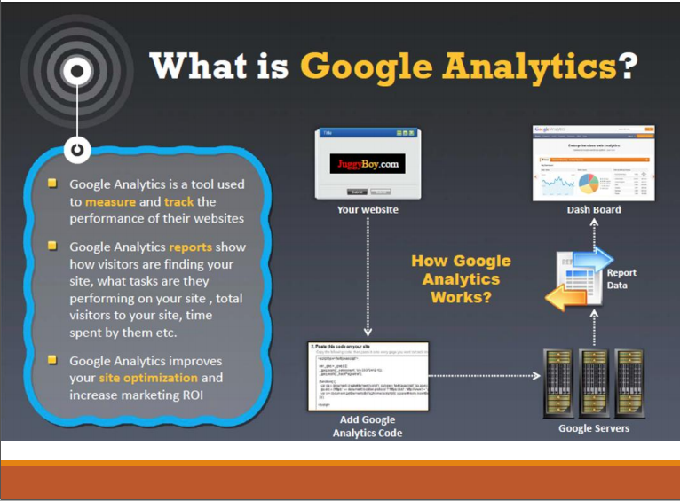

Slide 21
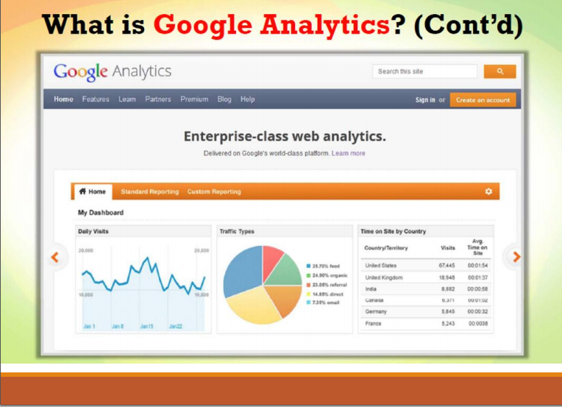

Slide 22
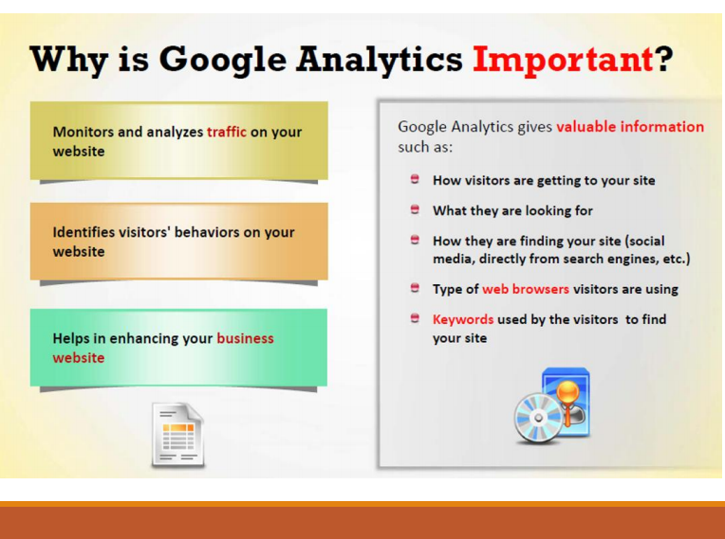

Slide 23
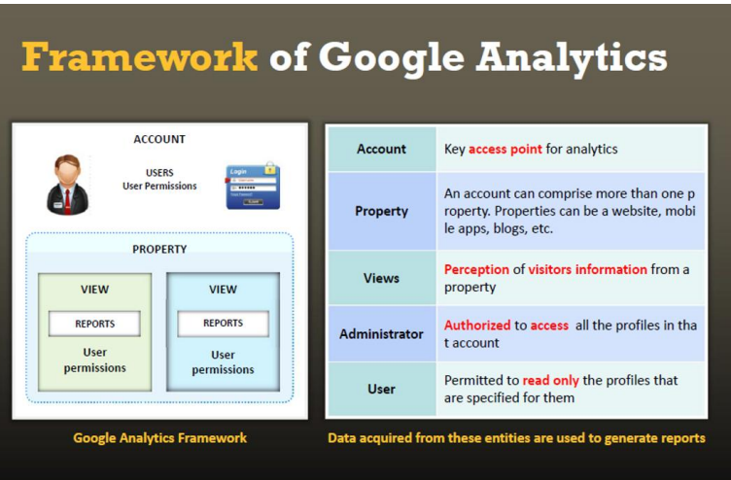

Slide 24
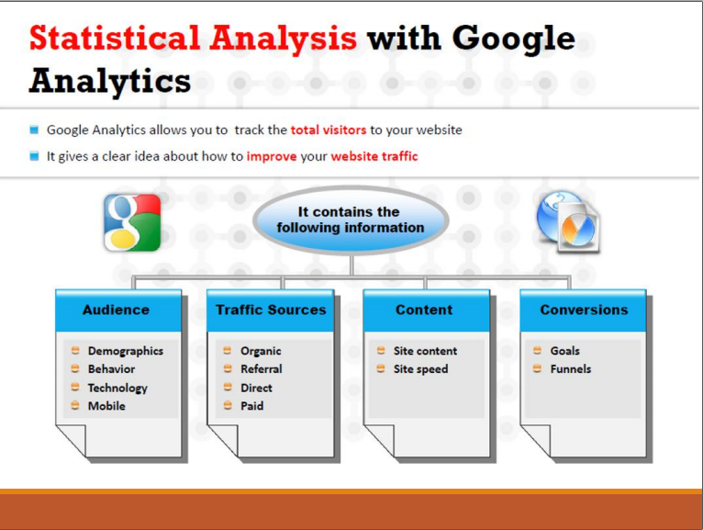

Slide 25
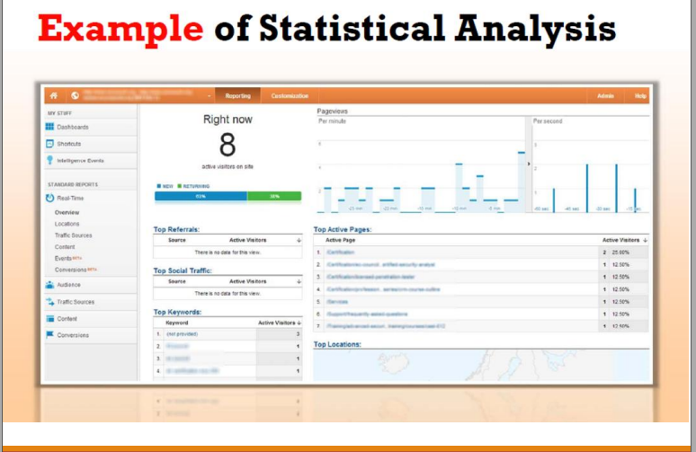

Slide 26
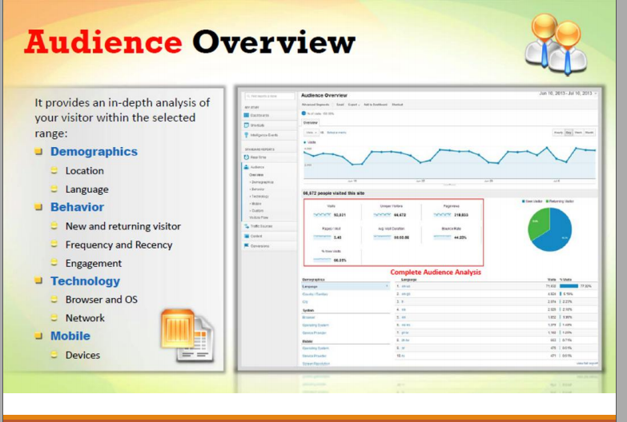

Slide 27
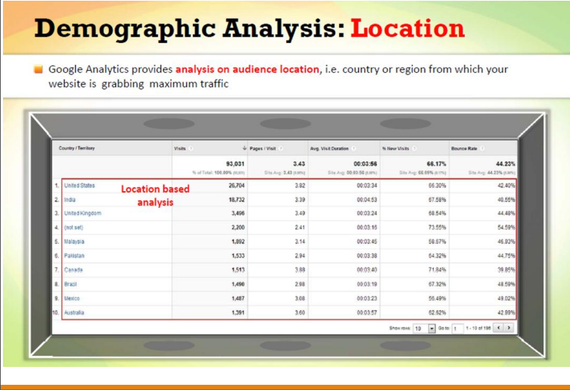

Slide 28
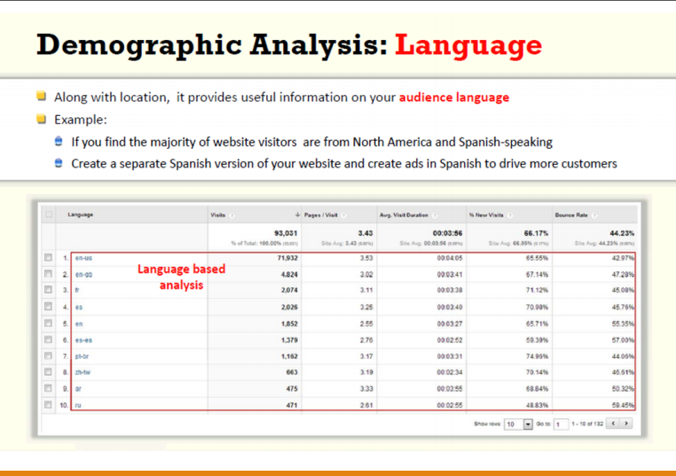

Slide 29
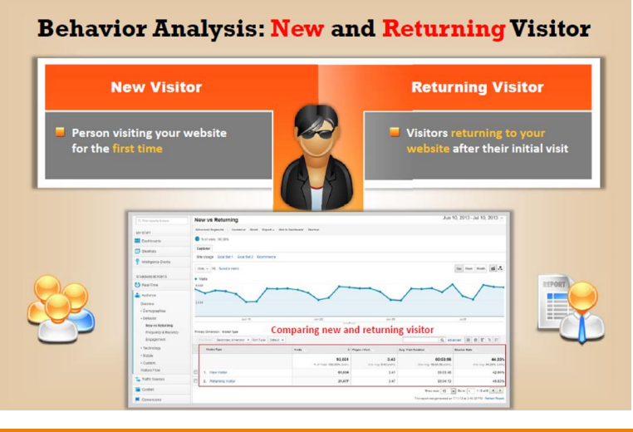

Slide 30
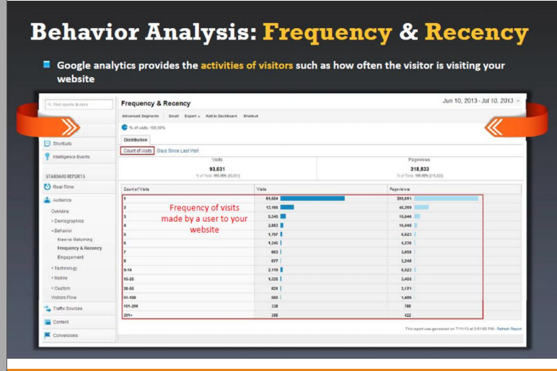

Slide 31
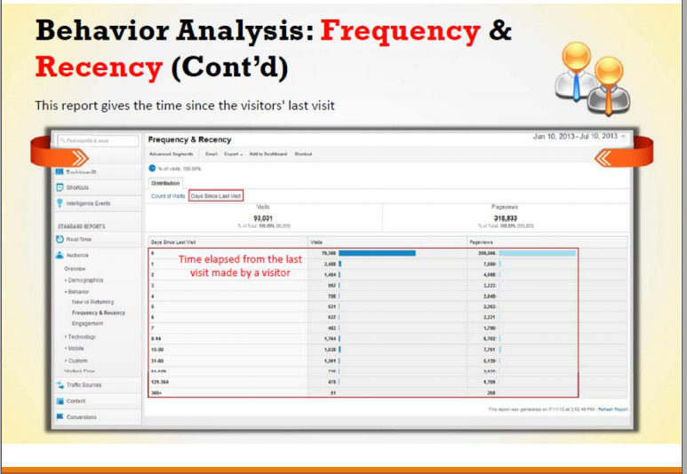

Slide 32
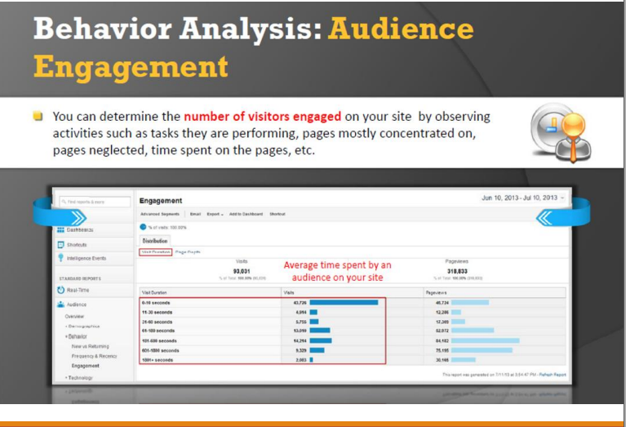

Slide 33
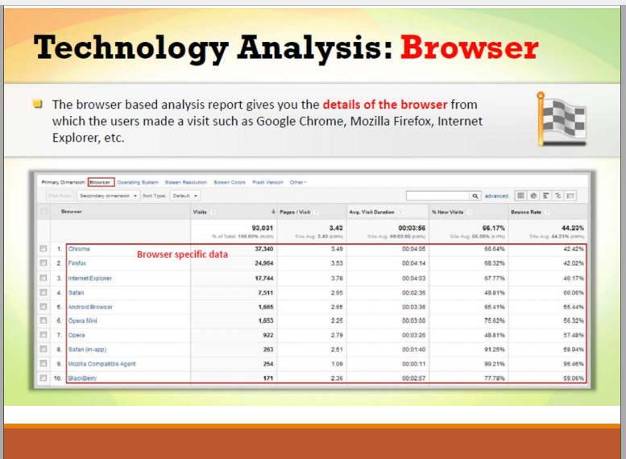

Slide 34
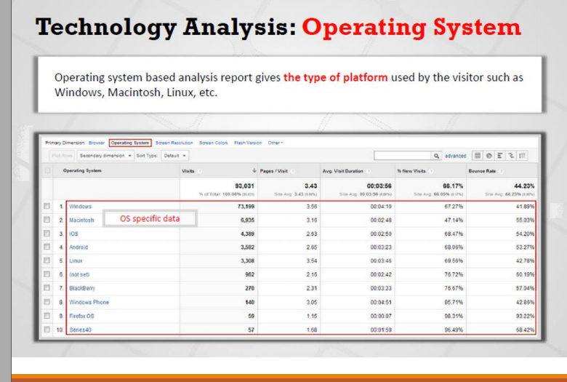

Slide 35
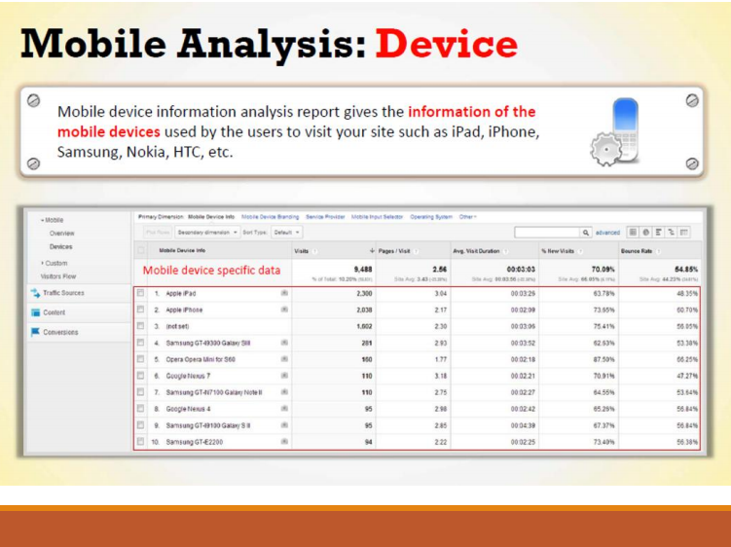

Slide 36
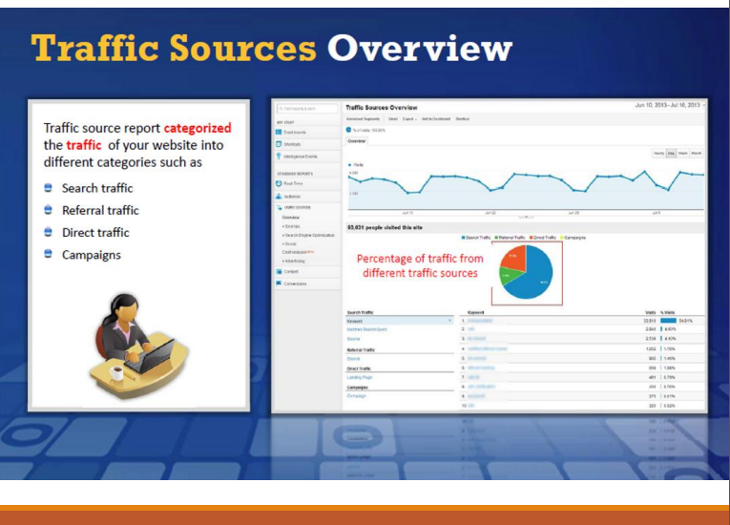

Slide 37
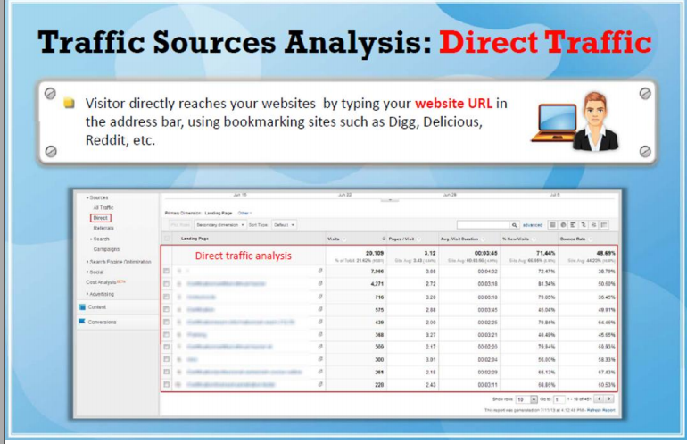

Slide 38
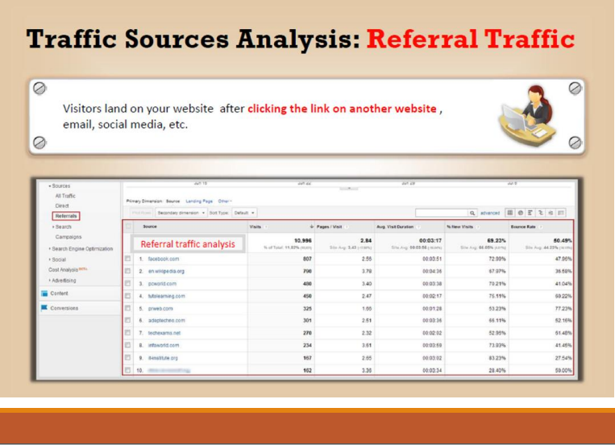

Slide 39
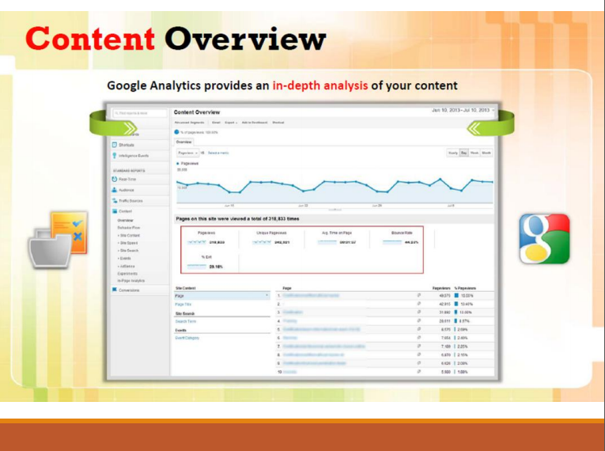

Slide 40
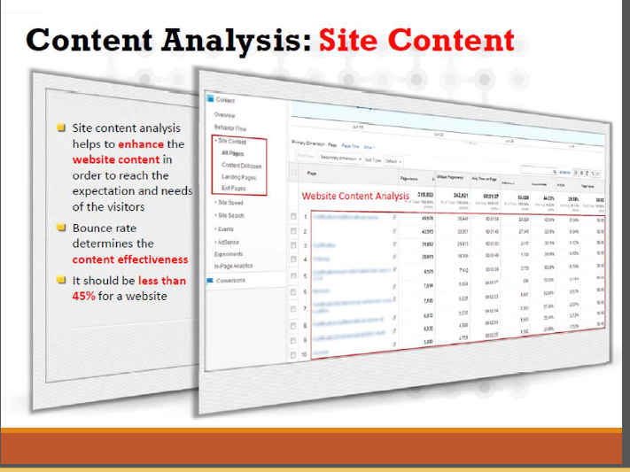

Slide 41
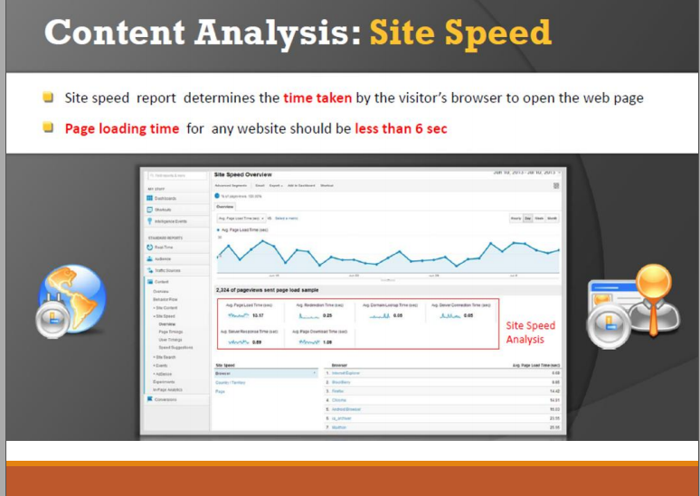

Slide 42
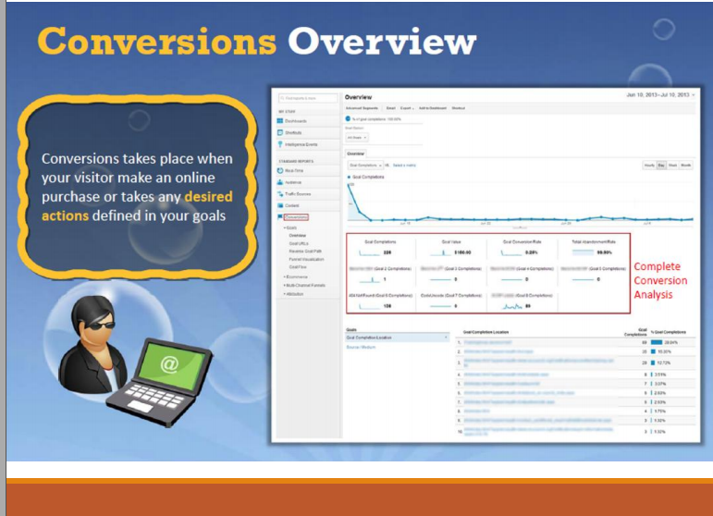

Slide 43
Contoh Web Analytics
Pada contoh web analytics diatas terlihat country Indonesia dengan analisa sbb :
UNTUK AQUISISI untuk mengetahui bagaimana pengguna tiba di situs Anda, laporan ini untuk mempelajari traffic anda tiba secara langsung ke situs Anda atau menggunakan mesin telusur Pengguna dari web 2
Pengguna 2
Penguna baru 1
Sessi yang dilihat 2
BEHAVIOR
Bouce rate ( keluar masuk web ) 50%
Page yang dilihat 2
Rata durasi melihat 9 detik
CONVERSION
Belum ada Goal conversion dan blm ada org yang melakukan pembelian ( Goal Completion dan Goal Value )

Slide 44
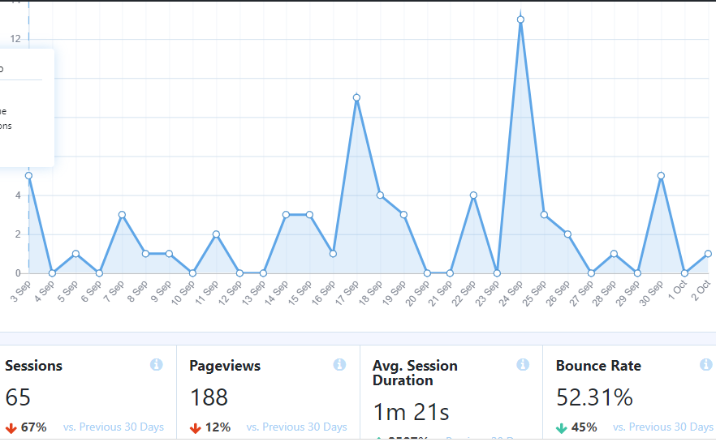
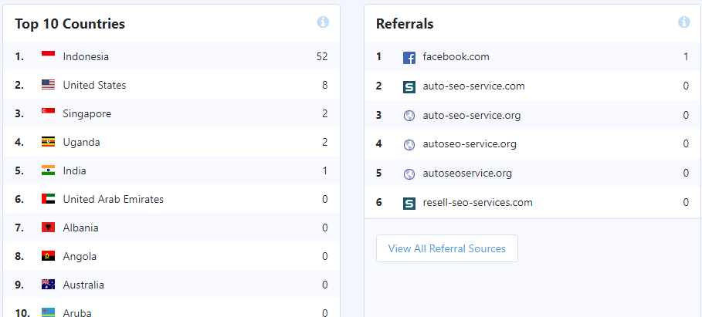
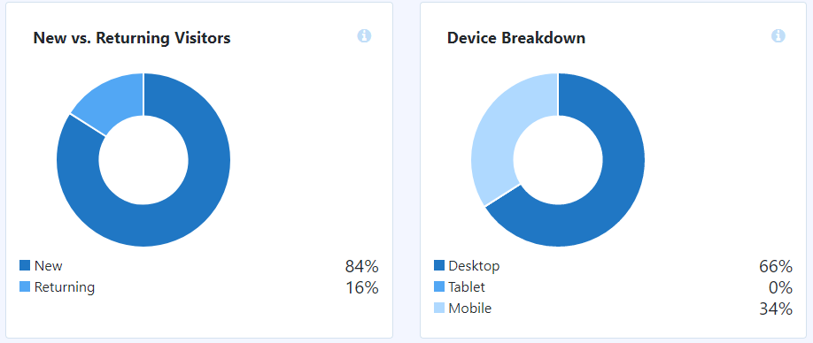
Berikut adalah analisa dari
Geography,
Penggunaan Device
Visitor
Page View
Sesion dam Bounce rate

Slide 45
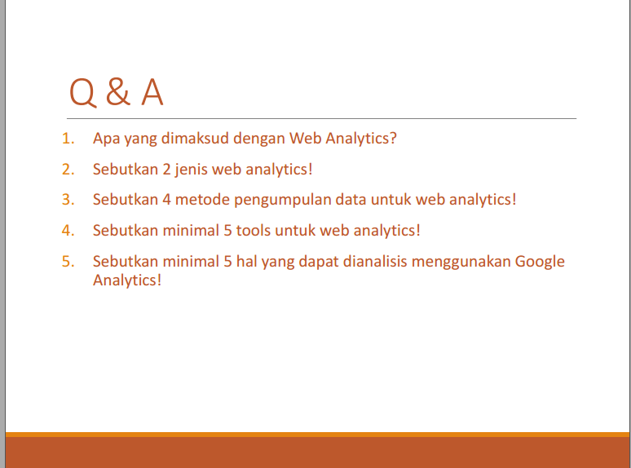
Kerjakan di classroom

